Slide 1
Analysing Networks
Notes:
Summary from VC2: results from trial survey; cholera; spatial spread model

Slide 2
Example: Name 2 people
Person | Contact1 | Contact2
Alicia | Julia | Ken
Andrew | Julia | Ken
Johann | Julia | Tom
Josh | Julia | Alicia
Julia | Andrew | Josh
Ken | Andrew | Alicia
Roberto | Julia | Ken
Tom | Johann | Josh

Slide 3
Measuring contacts
The out-degree is the number of people the student named:
A1
The in-degree is the number of people who named the student:
A1
Two students who each name each other form a mutual link
A1
A4

Slide 4
Add degree data
Person | Contact1 | Contact2 | Out-Degree | In-degree | Mutual Links
Alicia | Julia | Ken | 2 | 2 | 1
Andrew | Julia | Ken | 2 | 2 | 2
Johann | Julia | Tom | 2 | 1 | 1
Josh | Julia | Alicia | 2 | 2 | 1
Julia | Andrew | Josh | 2 | 5 | 2
Ken | Andrew | Alicia | 2 | 3 | 2
Roberto | Julia | Ken | 2 | 0 | 0
Tom | Johann | Josh | 2 | 1 | 1

Slide 5
Network structure
Johann
Julia
Roberto
Andrew
Tom
Josh
Alicia
Ken

Slide 6
Network structure
Johann
Tom
Josh
Julia
Alicia
Andrew
Roberto
Ken

Slide 7
Network structure
Roberto
Ken
Andrew
Johann
Julia
Tom
Josh
Alicia

Slide 8
Degree distribution
We can plot the degree distribution as a histogram
In-degree
Mutual degree
Notes:
Sixth formers might want to think about the distribution
Another thing best done on the flip chart?

Slide 9
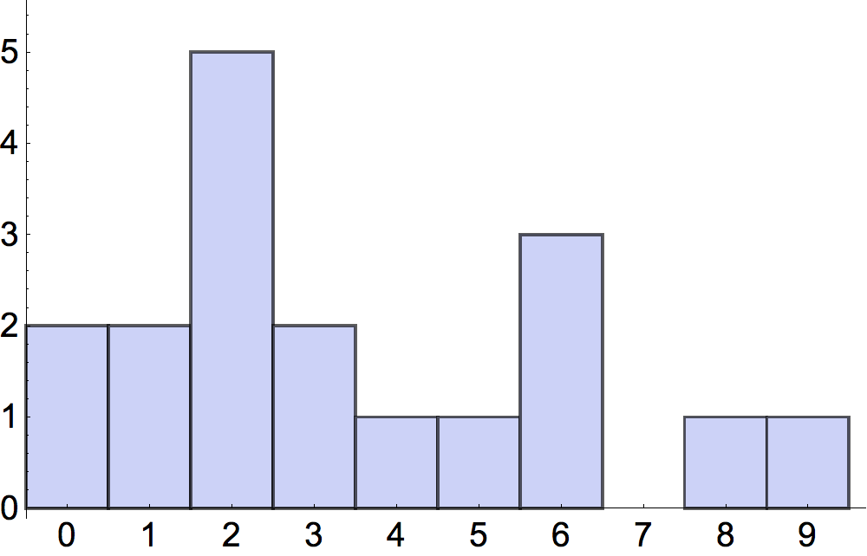
‘Average’ degree
Mean: add up values and divide by number of values
Median: sort values into order and pick middle one
Mode: pick most frequent value
Mean = 4.3
Median = 3
Mode = 2
degree
Notes:
Sixth formers might want to think about the distribution
Another thing best done on the flip chart?

Slide 10
Cliques
A clique in a network is a set of points in which every pair of points is connected.
E.g. a group of friends who all name each other.
6
5
7
8
4
2
10
9
12
11
1
3

Slide 11
Triangles
Finding cliques in large networks is hard.
A triangle is a simple clique that is usually easier to find.
1
2
The number of triangles is a simple way to assess how socially clustered the network is.
8
3
4
5
6
9
10
7
Four triangles:

Slide 12
Ages 7-8
Ages 10-11
Notes:
This for 5 mins.
Report back

